Slide 1
Employee Data Analysis using Excel
STUDENT NAME: KEERTHANA S
REGISTER NO: 312209387
NAAN MUDHALVAN ID:3CF1F5CBC1DE322AFA546C57BF434F03
(asunm1353312209387)
DEPARTMENT: B.COM (GENERAL)
COLLEGE: ANNA ADARSH COLLEGE FOR WOMEN-CHENNAI

Slide 2
PROJECT TITLE
Employee Performance Analysis using Excel

Slide 3


AGENDA
Problem Statement
Project Overview
End Users
Our Solution and Proposition
Dataset Description
Modelling Approach
Results and Discussion
Conclusion
3/21/2024 Annual Review

Slide 4


PROBLEM STATEMENT
Employee performance analysis is important for an organization because it helps
identify strengths and areas for
improvement, enhancing overall productivity and efficiency.
It ensures that employees are aligned with organizational goals,
leading to better decision-making, targeted training, and fair recognition.
Additionally, it fosters a culture of accountability and continuous development
within the organization.

Slide 5

PROJECT OVERVIEW
In this project, employee performance data analysis using Excel has been done to identify trends and patterns among different categories of employees—namely high, medium, and low performers. The analysis involved assessing performance scores and ratings to understand how employees are distributed across these categories and to uncover factors influencing their performance levels. By visualizing the data and exploring key metrics, the project aimed to provide insights that could help in designing targeted interventions for improving employee productivity and optimizing resource allocation within the organization.
.

Slide 6

WHO ARE THE END USERS?
1.Human Resources (HR) Managers
Team Leaders and Supervisors
Senior Management and Executives
Learning and Development (L&D) Specialists
Performance Analysts and Data Analysts
Individual employees.
Organizations.
Etc.,

Slide 7

OUR SOLUTION AND ITS VALUE PROPOSITION
Conditional formatting
Filter – to remove missing data
Formula – to find employees performance level
Table inserted
Pivot table - summary
Graph - visualization

Slide 8
Dataset Description
Employee Data set has been taken from : Kaggle
It had 26 Features from which we used only 10 features such as;
Employee ID – numerical data
First name& Last name – text
business unit – categorical
employee type – categorical
employee classification type – categorical
department type – categorical
gender – categorical
employee rating – numerical
performance level – text

Slide 9

THE "WOW" IN OUR SOLUTION
Formula used to convert numerical value to text categories - =IFS(O2>=5,“very high”,O2>=4, “high”, O2>=3, “Med”, TRUE, “LOW”)
Added slicer to view department wise employee performance
3/21/2024 Annual Review
9

Slide 10
MODELLING
Data collection :
Employee data collected from Kaggle.
Feature collection:
Identified the necessary data that is useful to do performance analysis.
Data cleaning:
Identified missing values using data bar / conditional formatting.
Filtered the missing values
Performance level:
1. Converted employee rating to performance level by using formula
Summary:
Inserted pivot table
Inserted Business units in Row, Performance level in column, count of name in values, gender as filter.
Also added slicer to view Department wise performance of employees.
10

Slide 11
Data Visualization:
1.With the inserted pivot table values , created visualization with bar chart
2. Slicer to view department wise employee performance .
3. With created visualization the insights extracted was made easy to understand easily by anyone.

Slide 12
RESULTS
12

Slide 13
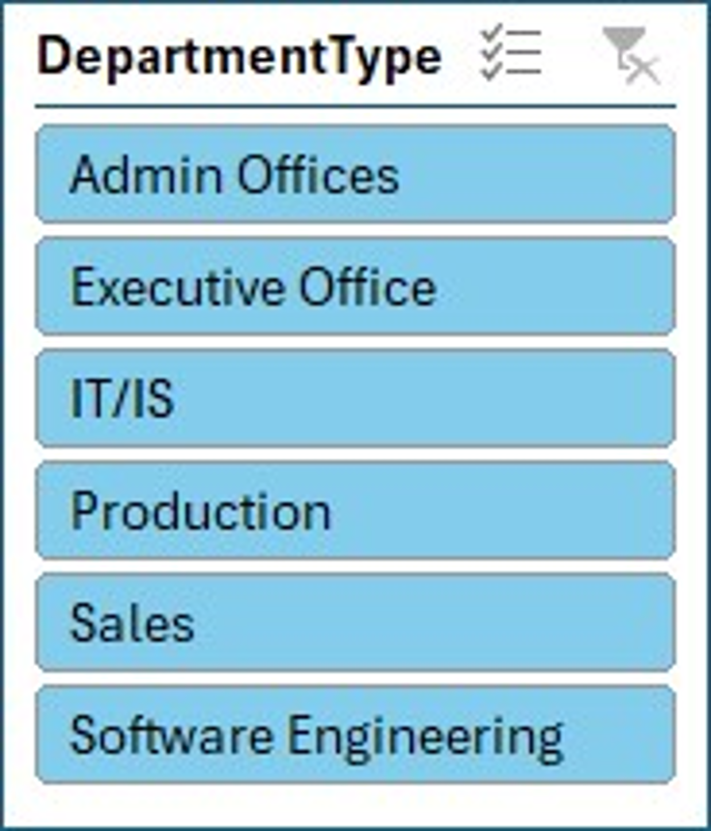
SLICER USED

Slide 14
conclusion
The employee performance data analysis, which involved comprehensive data collection from Kaggle and meticulous data cleaning and transformation, provided valuable insights into the performance distribution across different business units. The visualization indicates that the majority of employees fall into the "Medium" performance category. This that suggests while many employees are meeting expectations, there is significant room for improvement to elevate their performance to higher levels.
The lower proportion of employees in the "High" and "Very High" performance categories indicates a potential gap in maximizing employee capabilities and achieving peak productivity. This could be due to various factors, such as lack of training, inadequate resources, insufficient motivation, or other organizational challenges.

Slide 15
To address this, the organization may benefit from implementing targeted development programs, such as advanced training workshops, mentorship opportunities, and performance incentive plans, to nurture talent and encourage a culture of excellence. Additionally, providing regular feedback and recognizing high performers can boost morale and inspire others to enhance their performance. By focusing on these areas, the organization can not only improve individual employee outcomes but also achieve greater overall efficiency and success. A strategic approach to employee development and performance management will be key in transforming medium-level performers into high achievers, ultimately driving the organization toward its goals.

